Slide 1
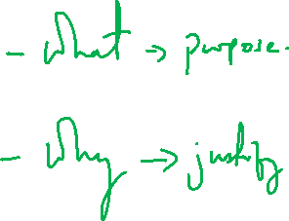
Dissertation Guidelines
Chapter 1 Introduction
Andre Samuel

Slide 2
Purpose of Chapter 1- Introduction
Contextualizes the study
Makes a case for the significance of the problem and the rationale for conducting the research
Establish the research purpose through RQ, Aim and Objectives
Provides an introduction to its basic components of the Dissertation

Slide 3
Note on Writing Style
Speak to your research i.e. refer to this study
  This research will………..
  The study will…………
  This research attempts to show that …
  The central thesis of this paper is that………
  This research investigates the factors that determine…….
http://www.phrasebank.manchester.ac.uk/

Slide 4
Chapter 1 Introduction
Outline Structure

Slide 5
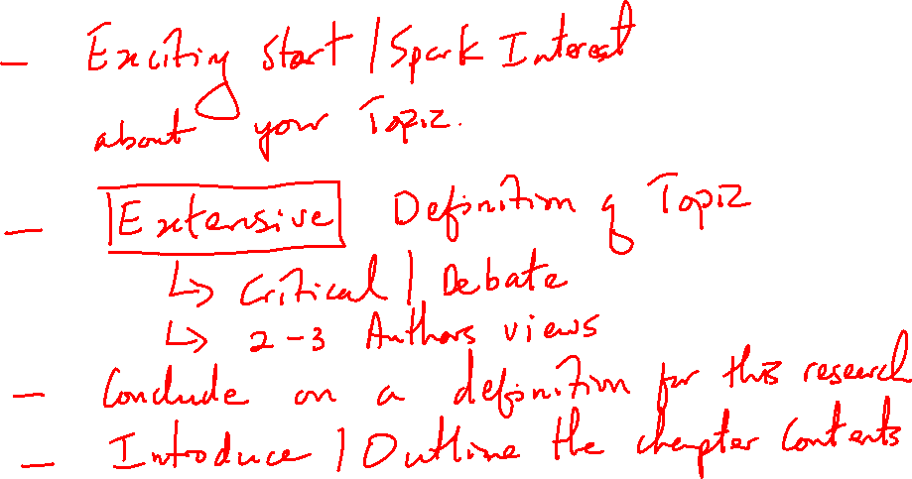
1.0 Introduction

Slide 6
1.1 Research Context and Issue

Slide 7
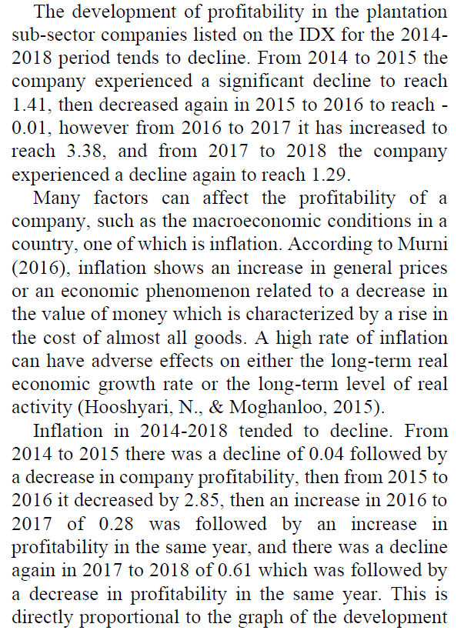
Example Issue using Empirical Evidence
Nugraha, N., Ramadhanti, A. and Amaliawiati, L. (2021) “Inflation, Leverage, and Company Size and Their Effect on Profitability”, Journal of Applied Accounting and Taxation, 6(1), pp. 63-70. doi: 10.30871/jaat.v6i1.2854.

Slide 9
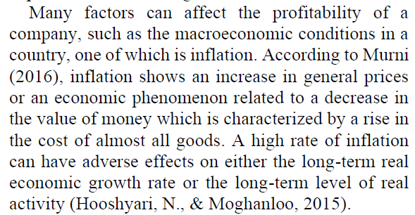
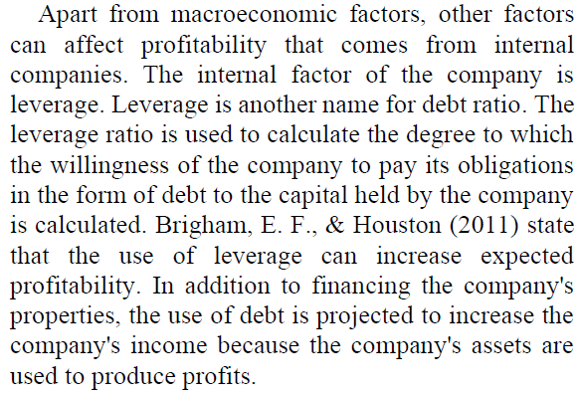
Example Issue using Literature
Nugraha, N., Ramadhanti, A. and Amaliawiati, L. (2021) “Inflation, Leverage, and Company Size and Their Effect on Profitability”, Journal of Applied Accounting and Taxation, 6(1), pp. 63-70. doi: 10.30871/jaat.v6i1.2854.

Slide 10
1.2 Rationale

Slide 11
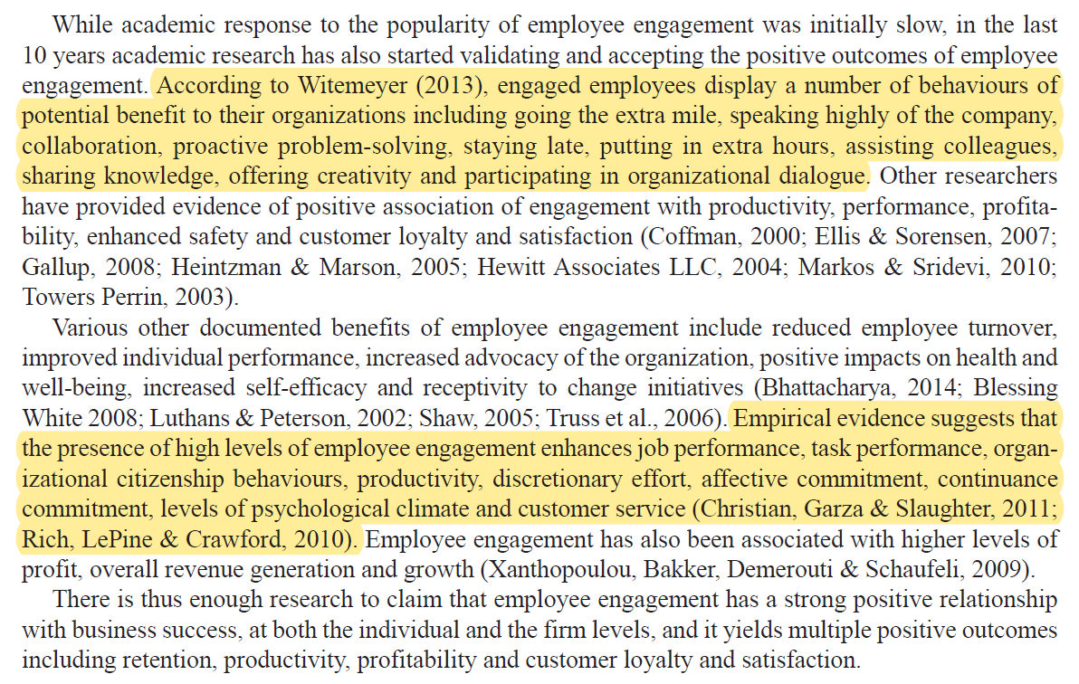
Example Rationale

Slide 12
1.3 Research Question

Slide 13
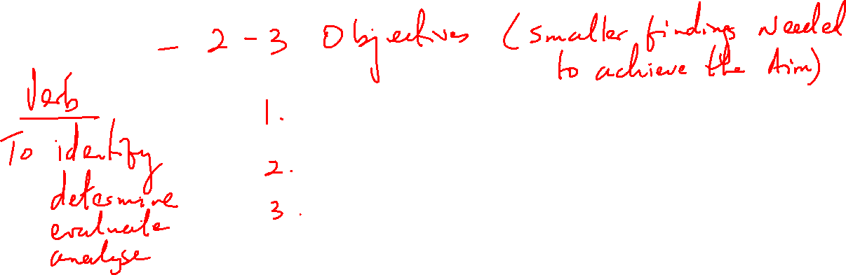

1.4 Objectives/Hypotheses

Slide 14
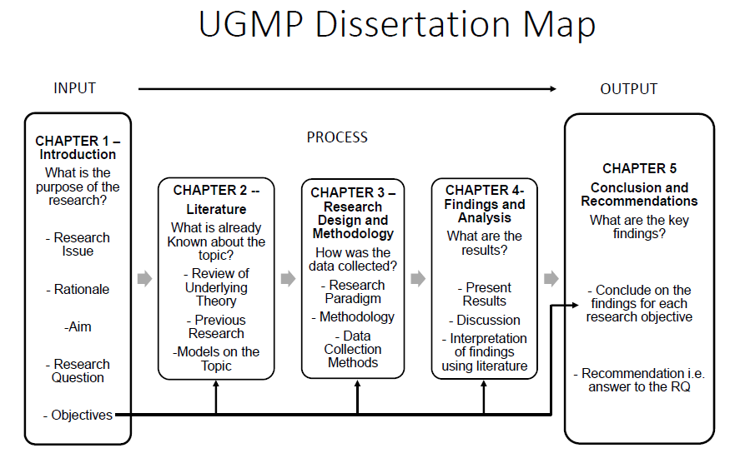
1.5 Dissertation Structure

Slide 15
Examples of RQ, Aim and Objectives
Using Secondary Data Only

Slide 16
Title- A Critical investigation of the financial performance of a Credit Union using Ratio Analysis
RQ: What are the key financial strengths and weaknesses of a credit union using Ratio Analysis?
Aim: To identify the overall financial health of the credit union with a focus on financial weaknesses and strengths
Objectives:
  To critically evaluate the capacity to make a profit and grow their business i.e. profitability
  To analyze the ability to meet short-term financial obligation, i.e. liquidity
  To determine the extent to which the credit union is using their business assets i.e. efficiently

Slide 17
Title- Analysis of Financial Statements to Evaluate the Performance in Sony Corporation.
RQ: What is the financial position of Sony Corporation for the period 2016 to 2018?
Aim: To analyse the performance of Sony Corporation over a three-year period in comparison to its competitors to determine the turnover and future risk.
Objectives:
  To critically analysis the accounting ratios in relation to the financial statements for the periods 2016 – 2018.
  To evaluate the trends and compliance to stated organizational targets
  To identify the financial gaps and challenges by benchmarking against industry best practices.

Slide 18
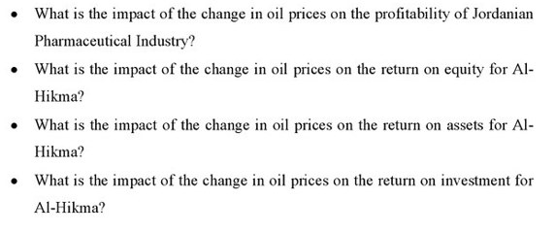
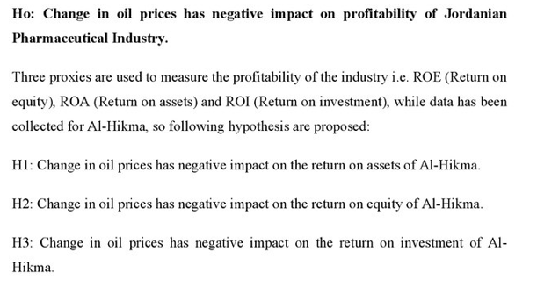
Title: The Impact of Change in Oil prices on the Profitability of Jordanian Pharma Industry
Research Questions
Hypotheses

Slide 19
A Financial Investigation into the Operational Health of Tata Global Beverages Limited using Ratio Analysis
Research Question
Objectives
To what extent can Ratio Analysis Influence Investor Decision?
1. To assess the operational health of Tata Global Beverages Limited using ratio analysis
2. To determine the financial risk level of Tata Global Beverages Limited
3. To calculate whether or not investment in Tata Global Beverages will be fruitful to stockholders

Slide 20
A Critical Analysis of the Determinants of Tax Morale in Asian Countries
Research Question
Objectives
What are the determinants of tax morale?
1. To evaluate trust in the government as a determinant of tax morale.
2. To evaluate religiosity as a determinant of tax morale.
3. To evaluate demographic and socio-economic factors as determinants of tax morale.

Slide 21
THE IMPACT OF COVID 19 PANDEMIC ON THE OIL AND GAS INDUSTRY FINANCIAL PERFORMANCE: a case study of Shell and BP
Research Question
Objectives
What are the impacts of Covid 19 Pandemic on the Oil and Gas Industry and its Financial Performance during that period?
1. To analyze the effects of the pandemic on oil and gas demand and supply.
2. To determine the losses the companies faced during the period 2020-2022

Slide 22
An Investigation into the Relationship between Stock Prices and Financial Performance of Commercial Banks listed on the Trinidad and Tobago Stock Exchange
Research Question
Objectives
To what extent does Financial Performance affect stock price for Commercial Banks Listed on the TTSE?
1. To evaluate the effect DPS on share price.
2. To evaluate the effect EPS on share price.
3. To evaluate the effect LIQ on share price.

